Slide 1

2) Analytics Fundamentals
Review of data, software, and statistics basics

Slide 2
Primary Scales of Measurement
i. Nominal Scale
ii. Ordinal Scale
iii. Interval Scale
iv. Ratio Scale
Notes:
1

Slide 3
Illustration of Primary Scales of Measurement

Slide 4
Primary Scales of Measurement

Slide 5
Spreadsheet Basics
Basic Excel Functions
=MIN(range)
=MAX(range)
=SUM(range)
=AVERAGE(range)
=STDEV(range)
=COUNT(range)
=COUNTIF(range,criteria)
=SUMIF(range,criteria)
=AVERAGEIF(range,criteria)

Slide 6
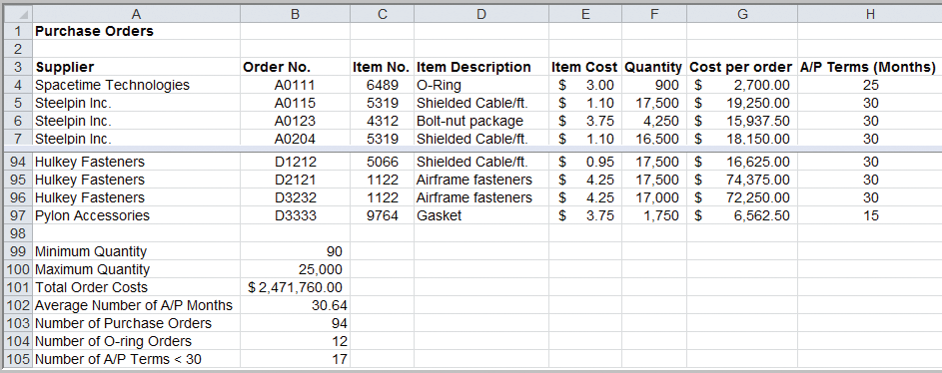
Excel Functions
Example Using Basic Excel Functions
=MIN(F4:F97)
=MAX(F4:F97)
=SUM(G4:G97)
=AVERAGE(H4:H97)
=COUNT(B4:B97)
=COUNTIF(D4:D97,”=O-Ring”)
=COUNTIF(H4:H97,”<30”)

Slide 7
Excel Functions
Logical Function:
=IF(condition, value if true, value if false)
=AND(condition1, condition2, …)
=OR(condition1, condition2, …)
Conditions may include the following:
= equal <> not equal to
> greater than >= greater than or equal to
< less than <= less than or equal to

Slide 8
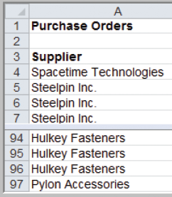
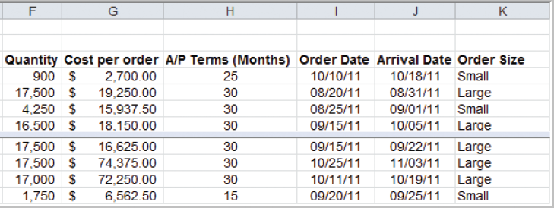
Example 2.5 Using the IF statement
=IF(condition, value if true, value if false)
Cell K4: =IF(F4 >= 10000, “Large”, “Small”)

Slide 9
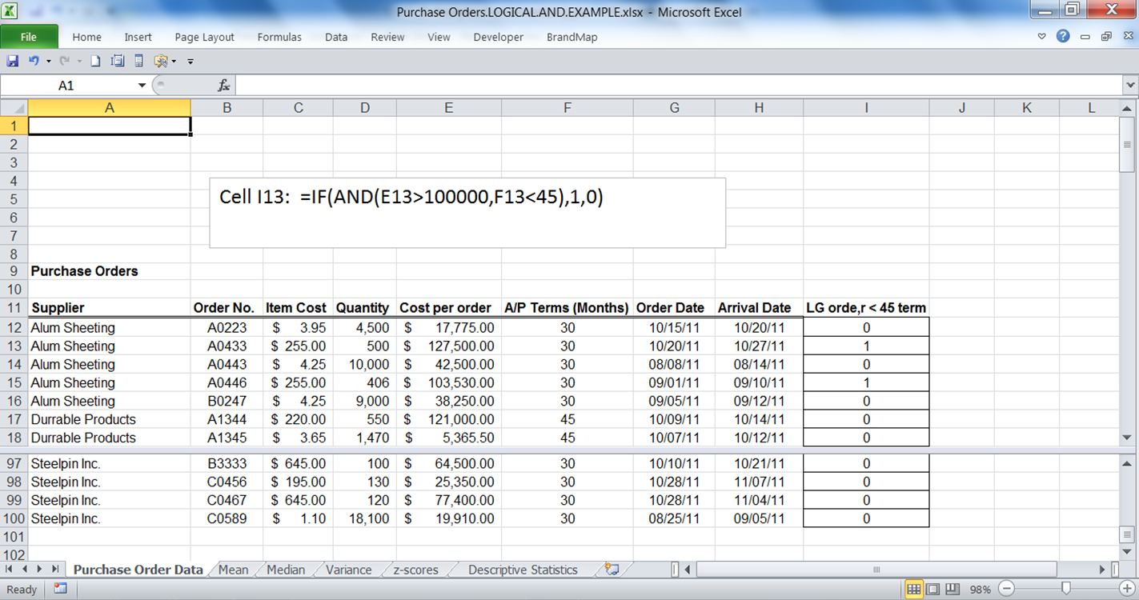
Using IF and AND

Slide 10
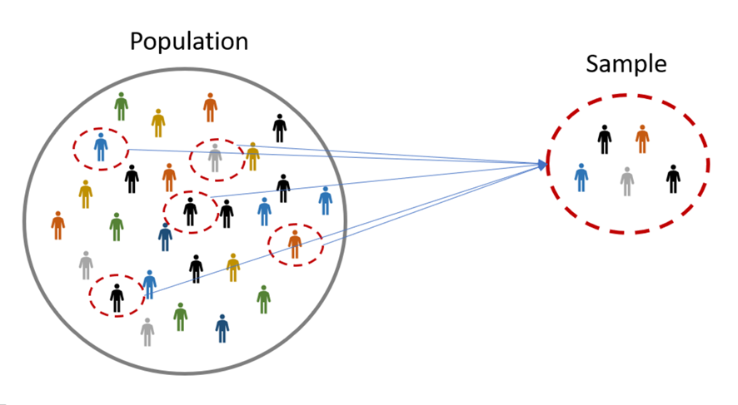
Statistical Terms and Concepts
Descriptive Statistics: Data summarization
Frequency distributions, Histograms
Measures of location
mean, median, mode
Measures of dispersion
variance, standard deviation, range
Inferential Statistics: Making inferences about the population based on sample information
Point estimates, Interval estimates, Hypothesis Tests

Slide 11
Statistical Terms and Concepts
Population- the total set of elements of interest
Sample- a subset of the population
Census- an investigation of all the population elements
Population parameters-characteristics of the population
Sample statistics- characteristics of the sample
Sampling frame- list of elements from which a sample may be drawn
Probability sample- a sample selected according to known probabilities
Notes:
1

Slide 13

SPSS Software Basics

Slide 14
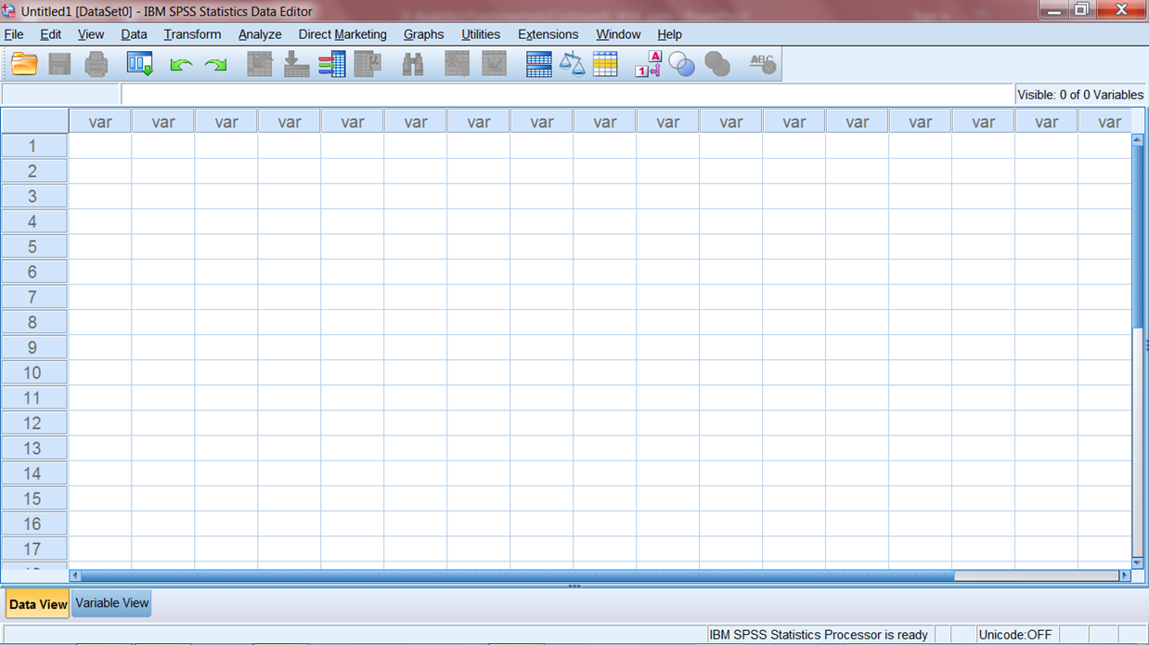
SPSS Basics The SPSS data view is much like a spreadsheet. Data may be typed in, imported or read from other sources such as Excel files, or previously created SPSS files (.sav files) may be loaded
Data View
Variable View Tab

Slide 15
SPSS Basics
As an exercise:
read in the satisfaction data from the Excel file “OverallSatData.xlsx”
Label the file in the Variable View
Construct a frequency distribution and histogram of the satisfaction scores, and obtain the descriptive statistics
Create a 0/1 variable indicating top two box score
Construct a 95% interval estimate for the proportion of top 2 box responses.
Save the file created as an SPSS (.sav) file

Slide 16
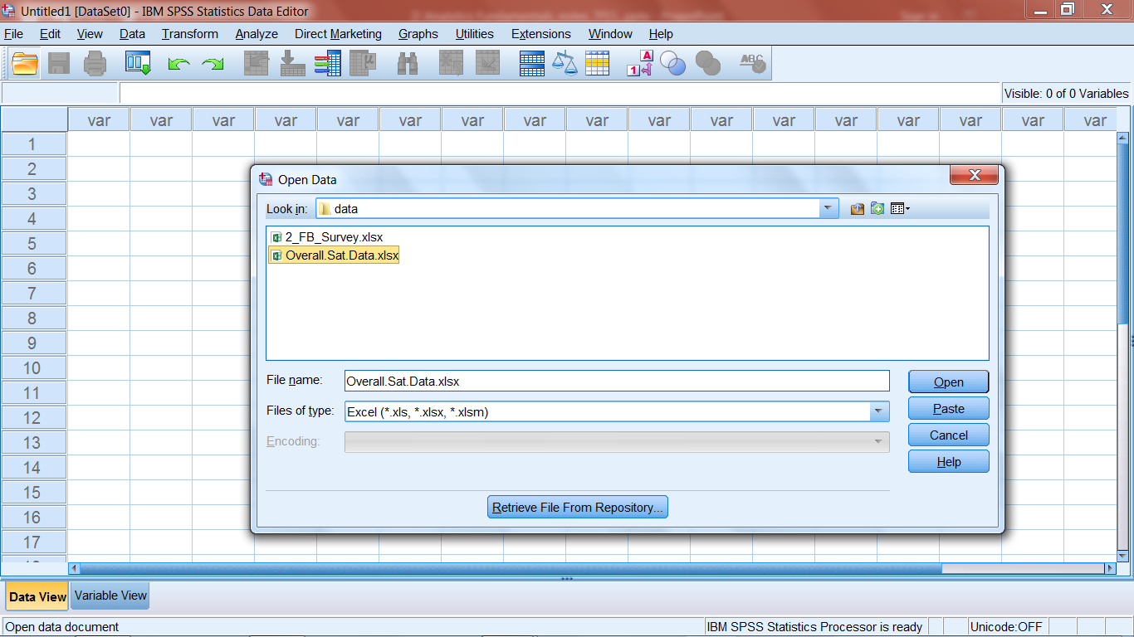
SPSS Basics: Loading the satisfaction data from the Excel file “Overall.Sat.Data.xlsx” Click: File, Open, Data Select Excel as file type, Click: Open and then OK

Slide 17
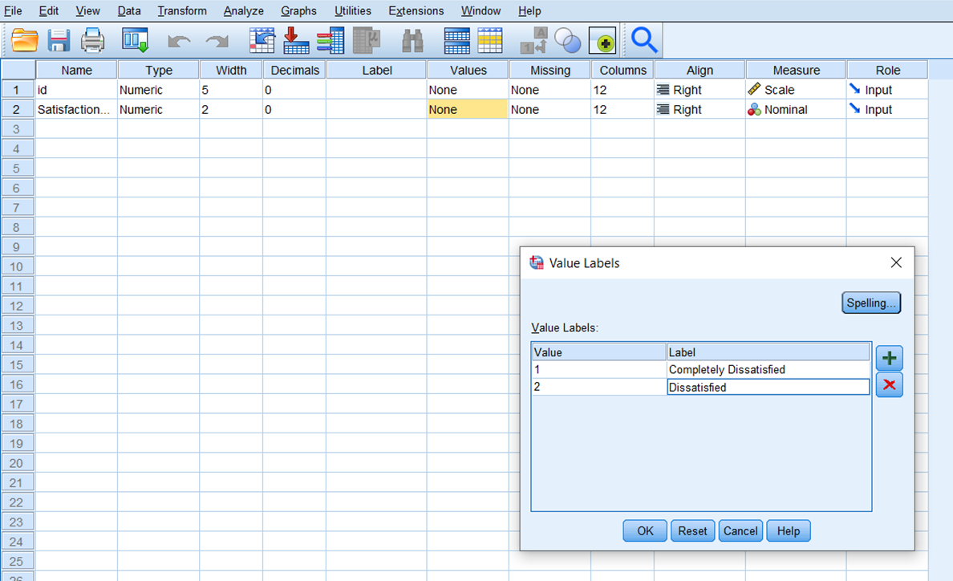
SPSS Basics : Label the values in the Variable View Click add (+) and enter values and labels. Click Ok when finished

Slide 18
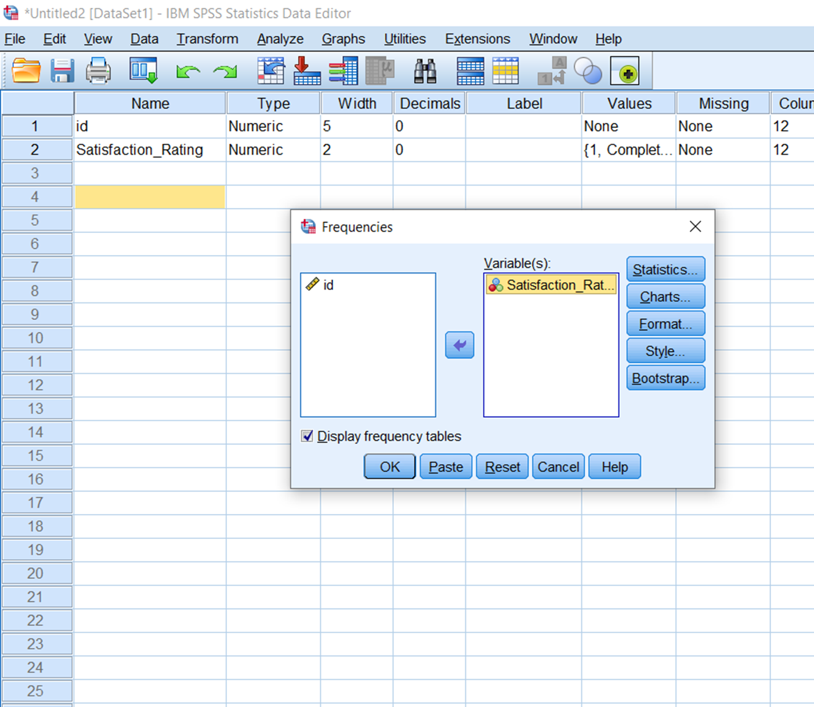
SPSS Basics: Construct a frequency distribution and histogram of the satisfaction scores, and obtain the descriptive statistics
Click Analyze, Descriptive Statistics, Frequencies and put the Satisfaction Rating variable into the Variable(s) window

Slide 19
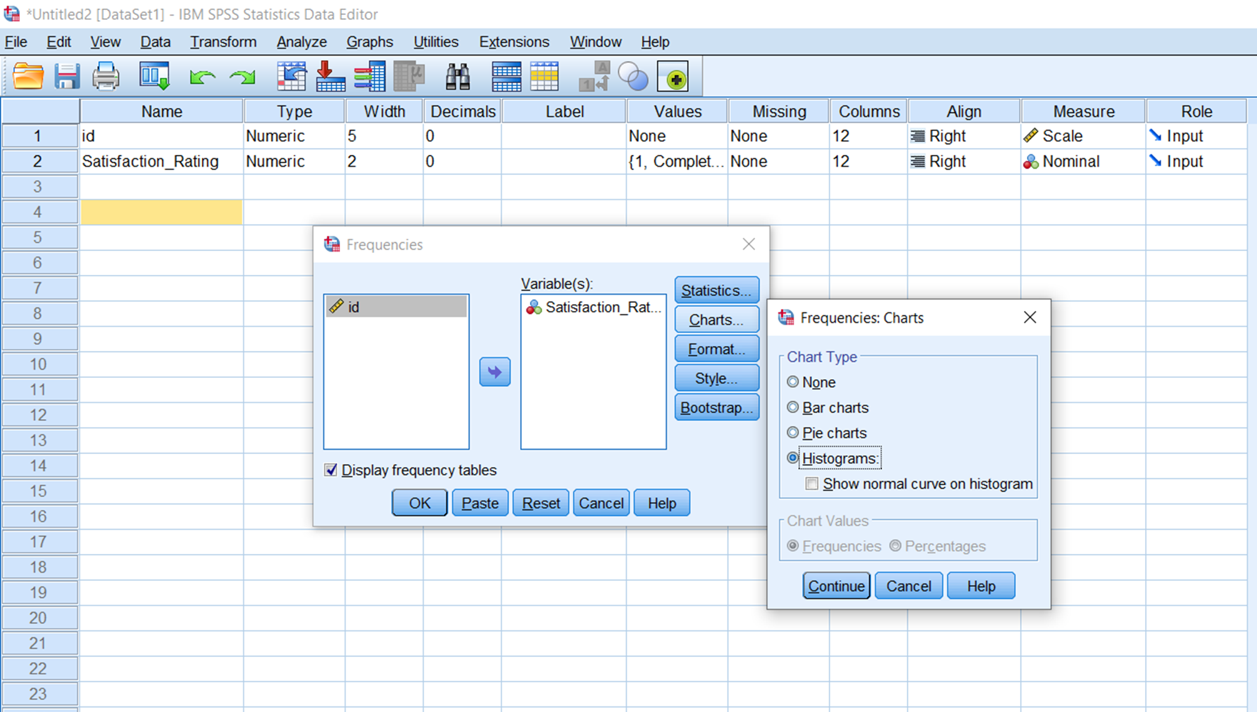
SPSS Basics: Construct a frequency distribution and histogram of the satisfaction scores, and obtain the descriptive statistics
Click Charts, select histograms, click continue, then click Ok

Slide 20
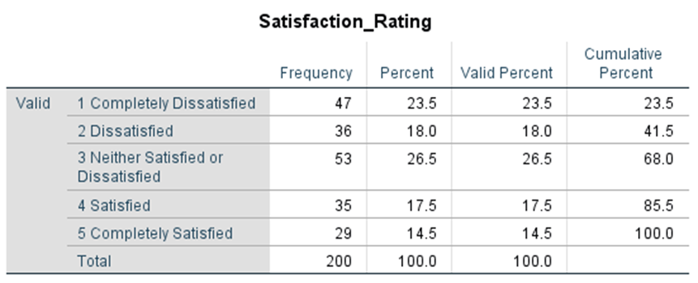
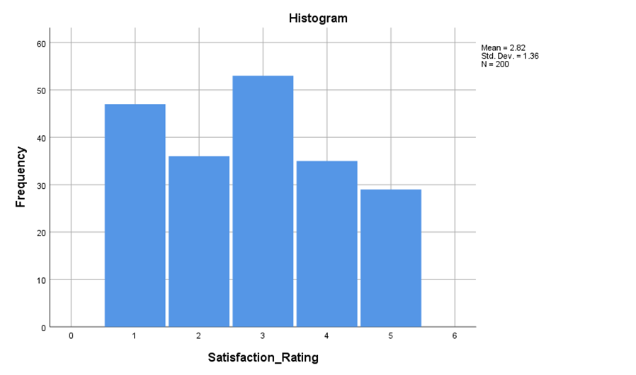
SPSS Basics: Construct a frequency distribution and histogram of the satisfaction scores, and obtain the descriptive statistics

Slide 21
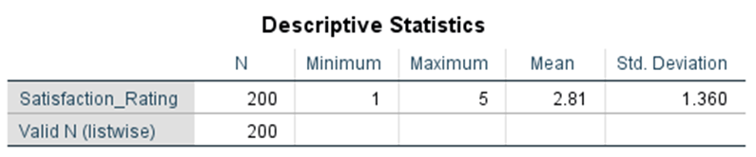
SPSS Basics: Construct a frequency distribution and histogram of the satisfaction scores, and obtain the descriptive statistics
For descriptives, Click analyze, descriptive statistics, descriptives. Put the Satisfaction Rating variable in the Variable(s) window and click Ok

Slide 22
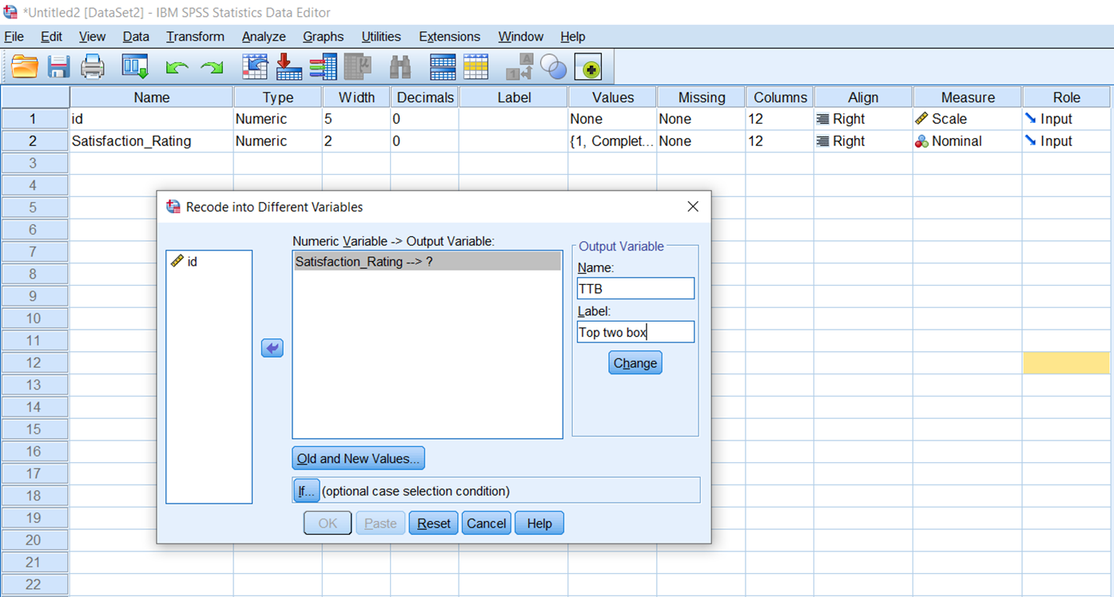
SPSS Basics: Create a 0/1 variable indicating top two box score
The Recode feature in SPSS can be used to create a 0/1 variable. Click Transform, Recode into different variables and complete as below.
Next click Old and New Values

Slide 23
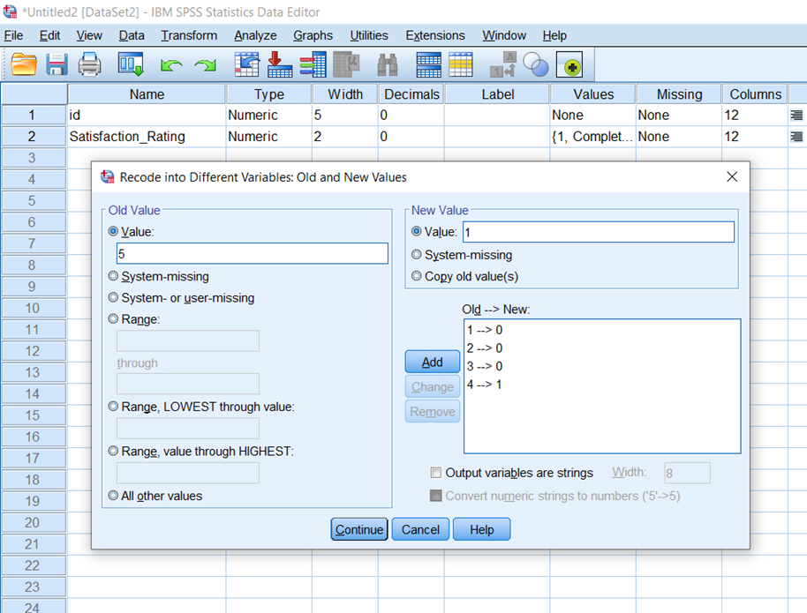
SPSS Basics: Create a 0/1 variable indicating top two box score using Recode
Specify the original (old) and recoded (new) values as below, clicking Add after each specification. When finished click Continue, Change, and then Ok

Slide 24
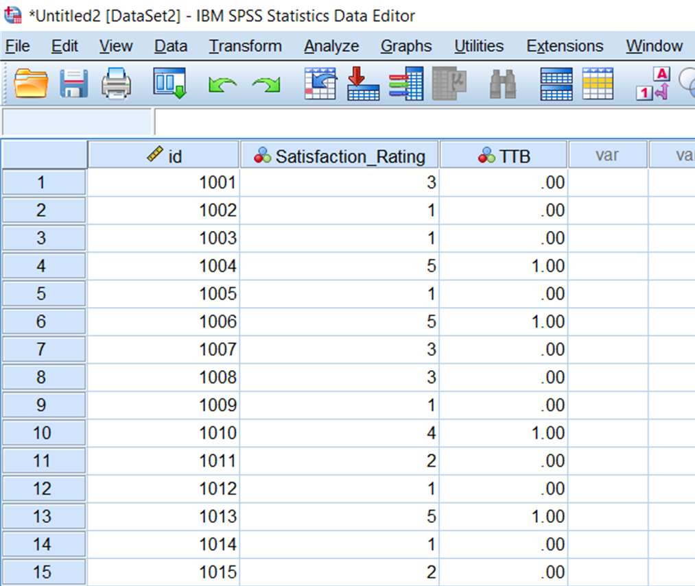
SPSS Basics: Create a 0/1 variable indicating top two box score using Recode

Slide 25
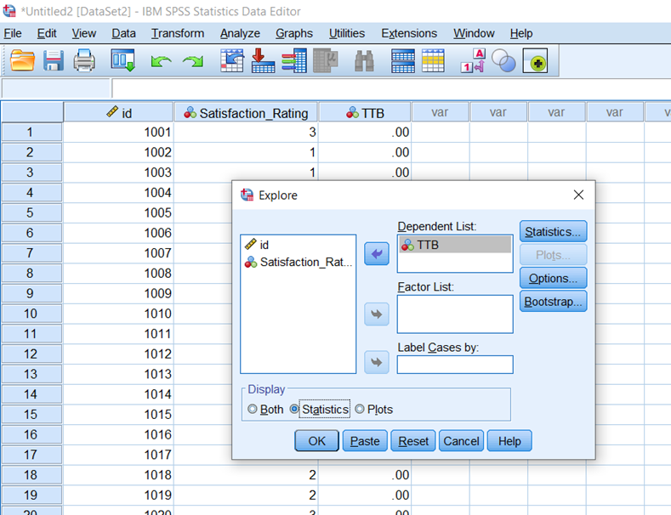
SPSS Basics: Construct a 95% interval estimate for the proportion of top 2 box responses.
Click Analyze, Descriptive Statistics, Explore
Put variable TTB in the Dependent List Window and click Ok

Slide 26
SPSS Basics: Construct a 95% interval estimate for the proportion of top 2 box responses.

Slide 27
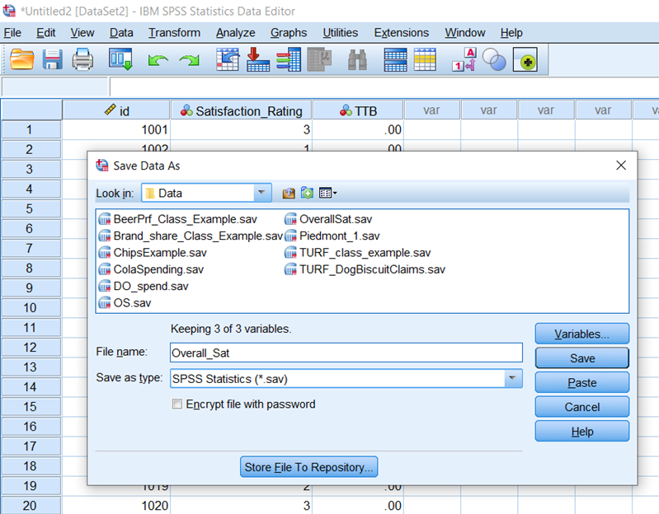
SPSS Basics: Save the file created as an SPSS (.sav) file
Click File, Save Data As (make sure the file type is .sav), and select a file name and location, and click Save

Slide 28
SPSS Basics: Select Cases and Split File
Select Cases and Split file are two handy SPSS features.
When Select Cases is invoked, all operations will only be performed on the cases selected per user specifications
When Split file is invoked, output is produced according to the user specified subgroup specifications.

Slide 29
SPSS Basics: Select Cases and Split File
Consider a data set with age category (1= younger, 2= older), gender (male=1, female=2), and weekly cola spending amounts for 1000 respondents, saved in SPSS file ColaSpending.sav.
In the following example, Select Cases is used to select only females, and descriptive statistics determined for that subgroup

Slide 30
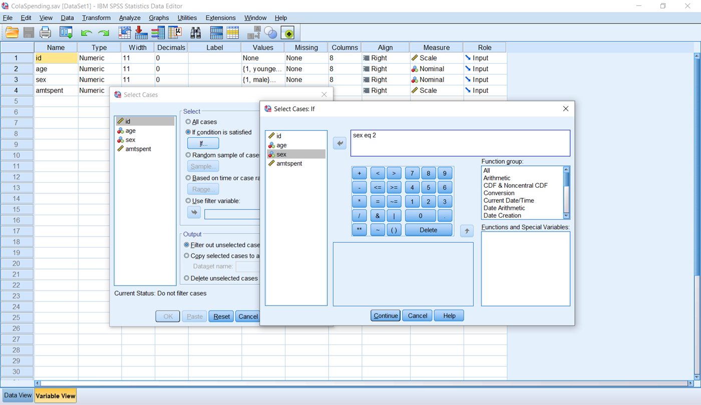
SPSS Basics: Select Cases
Click: Data, Select Cases, next select If condition is satisfied, then click If.
Next enter the condition sex =2 and click Continue, Ok

Slide 31
SPSS Basics: Select Cases
Computing descriptive statistics for the amtspent variable will only produce results for females
Remember to return to the Select Cases feature and Select all to turn off the select feature

Slide 32
SPSS Basics: Split File
With Split File turned on, all output is presented by all subgroups specified.
For our cola spending file, Split File will be used to present descriptive statistics results by both male and female groups.
To invoke Split File, Click Data, Split File, select organize output by groups and put the sex variable in the Groups base on window, and click Ok

Slide 33
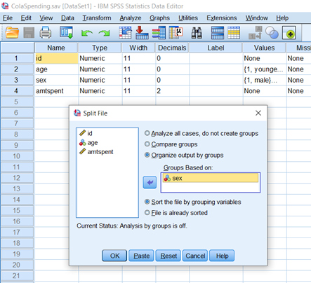
SPSS Basics: Split File

Slide 34
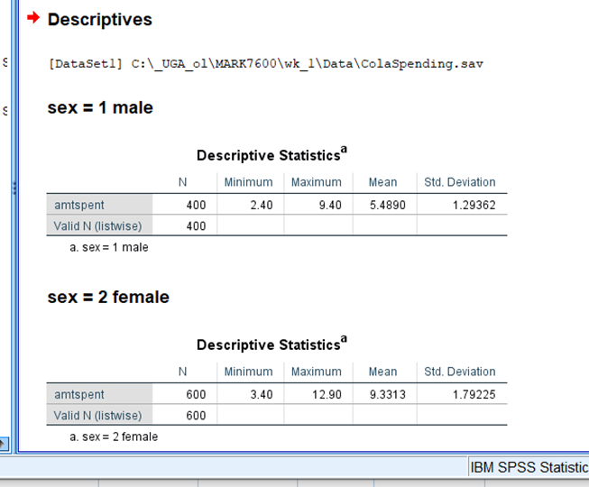
SPSS Basics: Split File
Remember to “turn off” Split File( select Analyze all cases …) when the feature is no longer desired

Slide 35
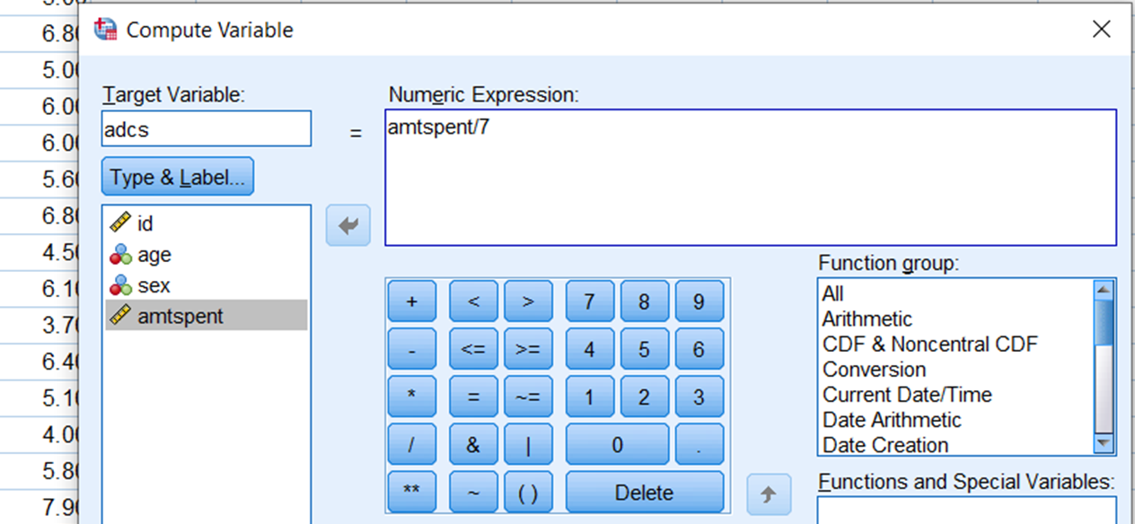
Creating a new variable with Compute Variable
For example, to compute avg. daily cola spending from weekly, create the variable adcs by clicking Transform > Compute Variable, and enter the appropriate items in Target Variable and Numeric Expression windows. Click Ok

Slide 36
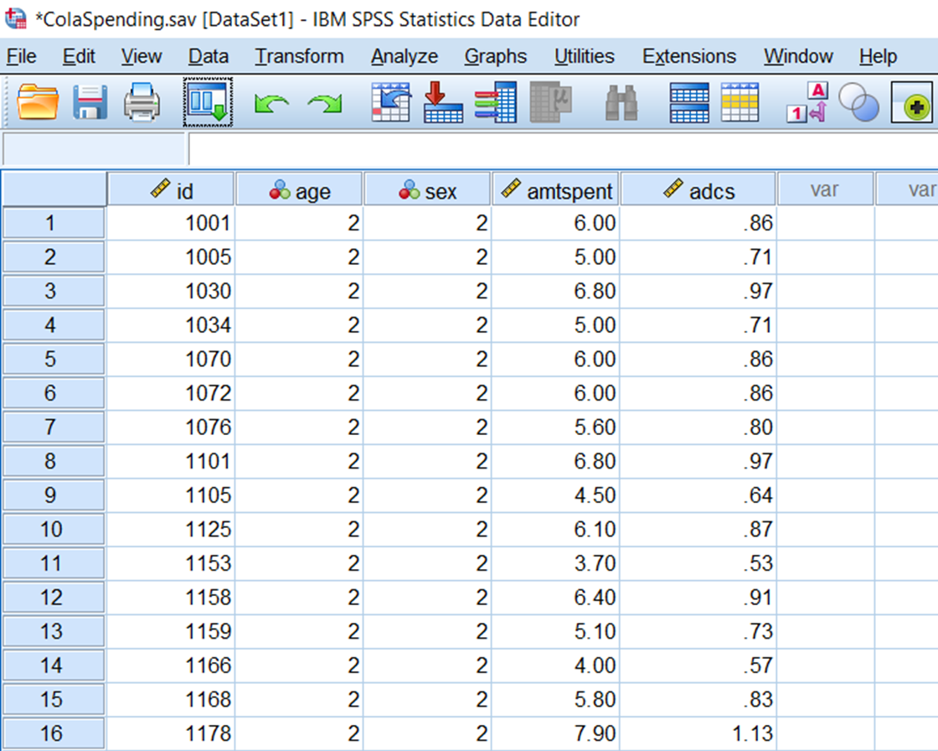
Click on the Data View tab to see the result

Slide 37
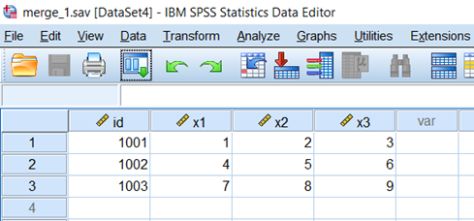
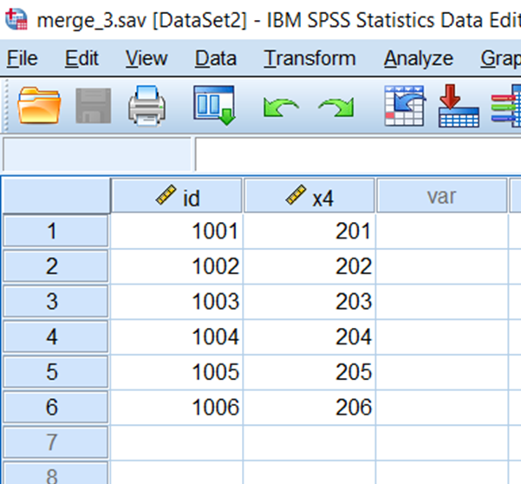
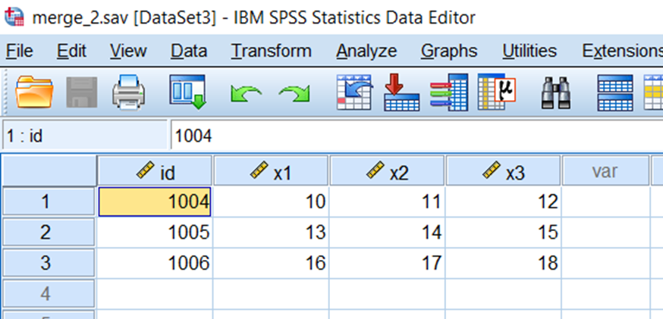
Merging Files by Adding Cases or Variables
To illustrate how to merge by either adding cases or variables, we will use the following files: merge_1.sav, merge_2.sav, and merge_3.sav. First, we will use the Add Cases feature to combine merge_1.sav and merge_2.sav (also called concatenation), and then use the Add Variables feature to add variable x4 from file merge_3.sav.

Slide 38
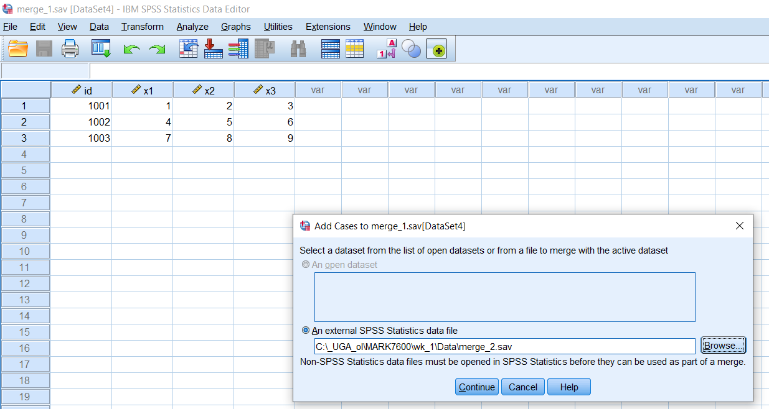
Adding Cases
Select Data > Merge Files > Add Cases > Browse
Click on the appropriate file, click Open, Continue and Ok

Slide 39
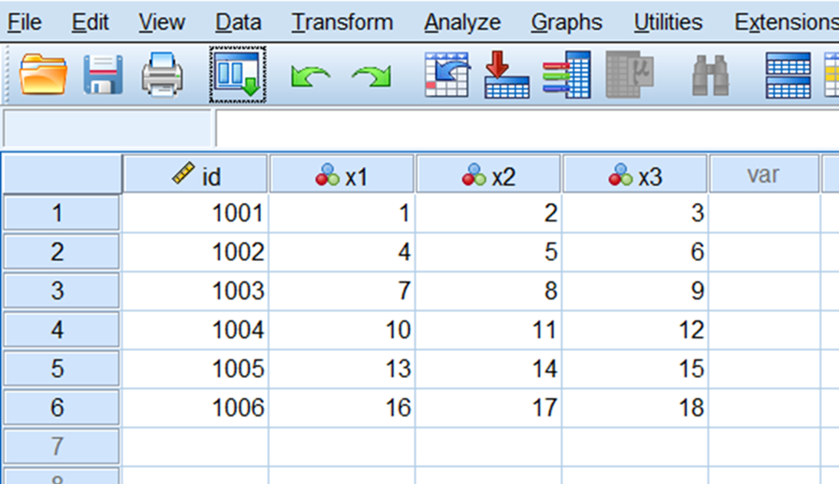
Click on Data View to view the merged result

Slide 40
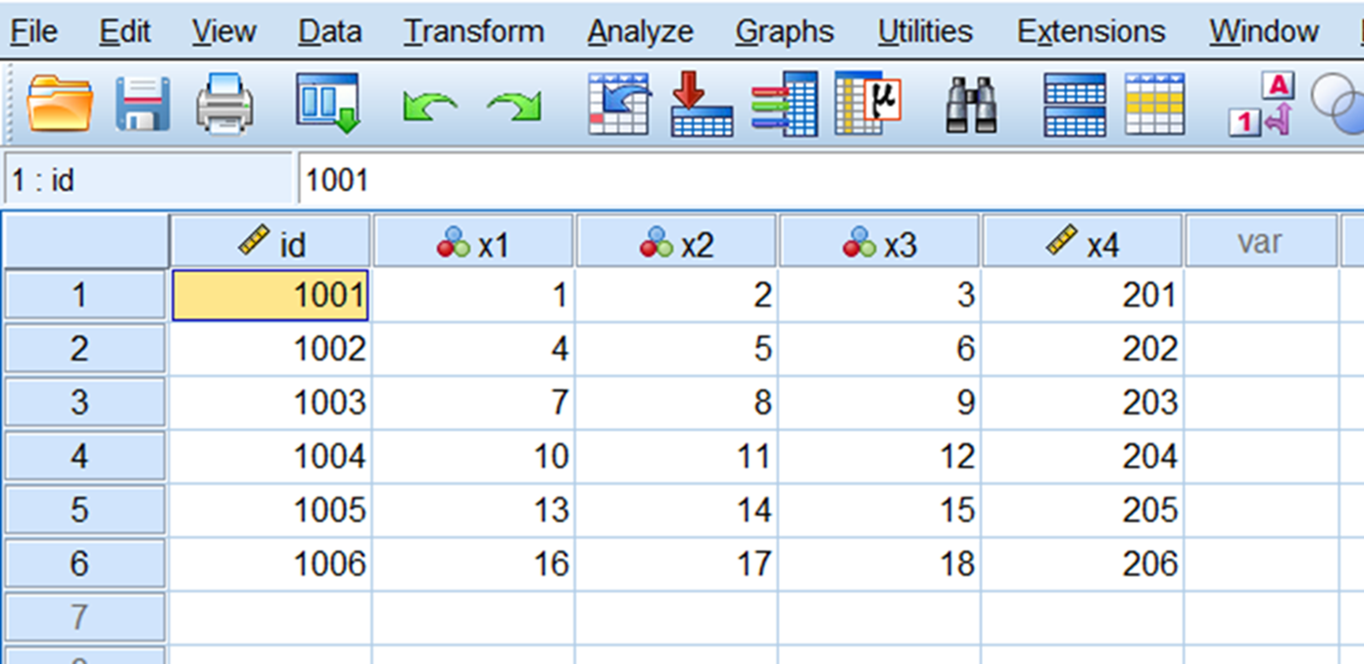
To combine variable X4, Click Data > Merge Files > Add Variables> Browse select the preproperate file and click Open >Continue, Ok Click on Data View to see the results

Slide 41

Example: The manufacturer of a women’s vitamin product is interested in determining the best advertising strategy. Management is considering print ads in Vogue, Allure, Glamour, and Better Homes. What type of analysis might be helpful?

Slide 42
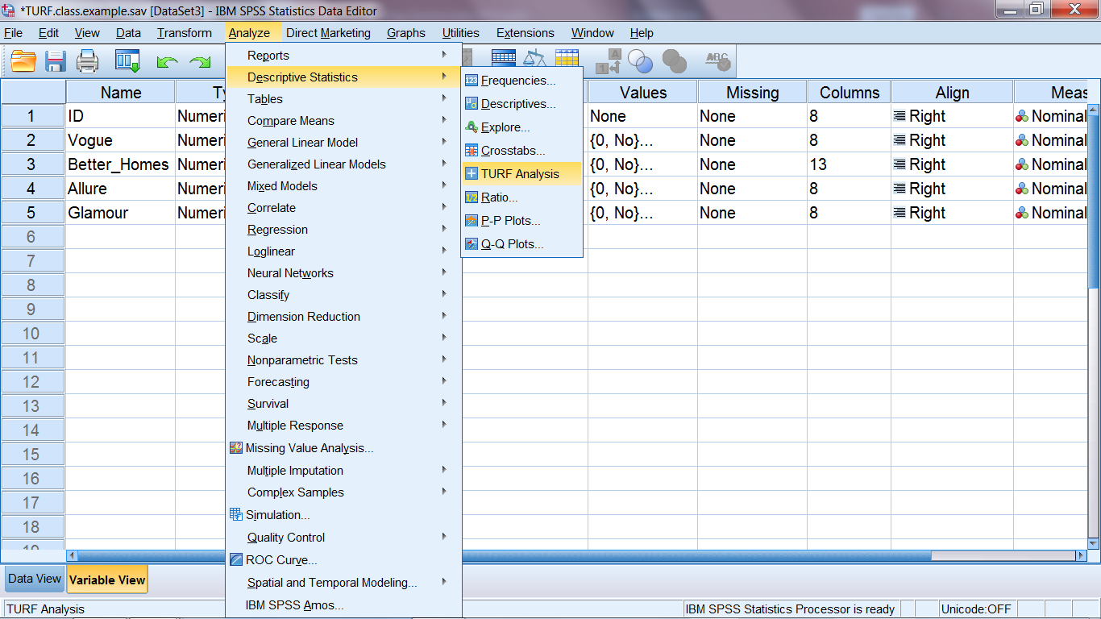
Running TURF Analysis
Open file “TURF.class.example.sav” and click Analysis, Descriptive Statistics, TURF Analysis

Slide 43
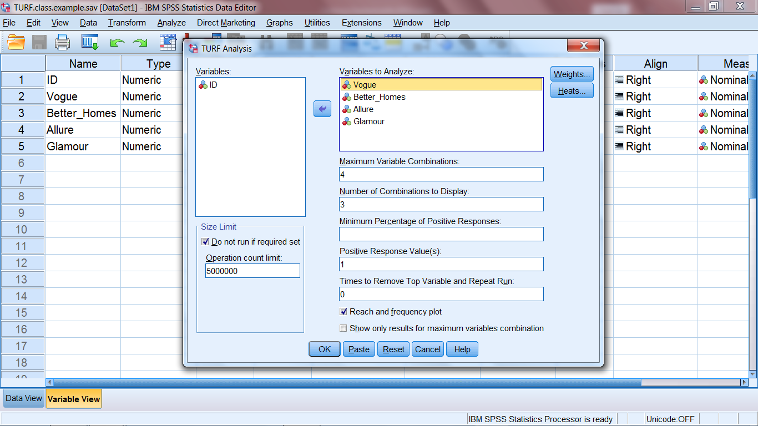
Load the TURF variables, input the specs and click Ok

Slide 44
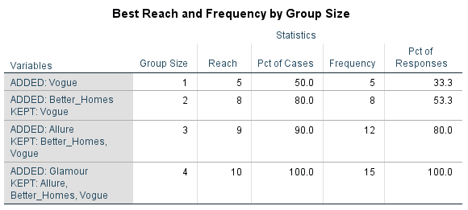

Slide 45

SAS Software Basics

Slide 46
Getting Started with SAS
Whether using the SAS Windows Environment or SAS OnDemand for Academics (which uses SAS Studio), the environment is essentially the same.
The environment consists of the following:
-Editor window (programming window): Contains your program statements.
-Log window: Contains a “log” of the processing of your program.
-Output window: Contains the output generated by the SAS procedures.
Data Steps and Proc Steps
SAS is organized into steps
Data steps: used to put data into a form that SAS can process
(e.g., read, write, perform calculations)
Proc steps: use procedures to do something to the data
(e.g., sort, analyze, print)
Statements end with a semicolon;

Slide 47
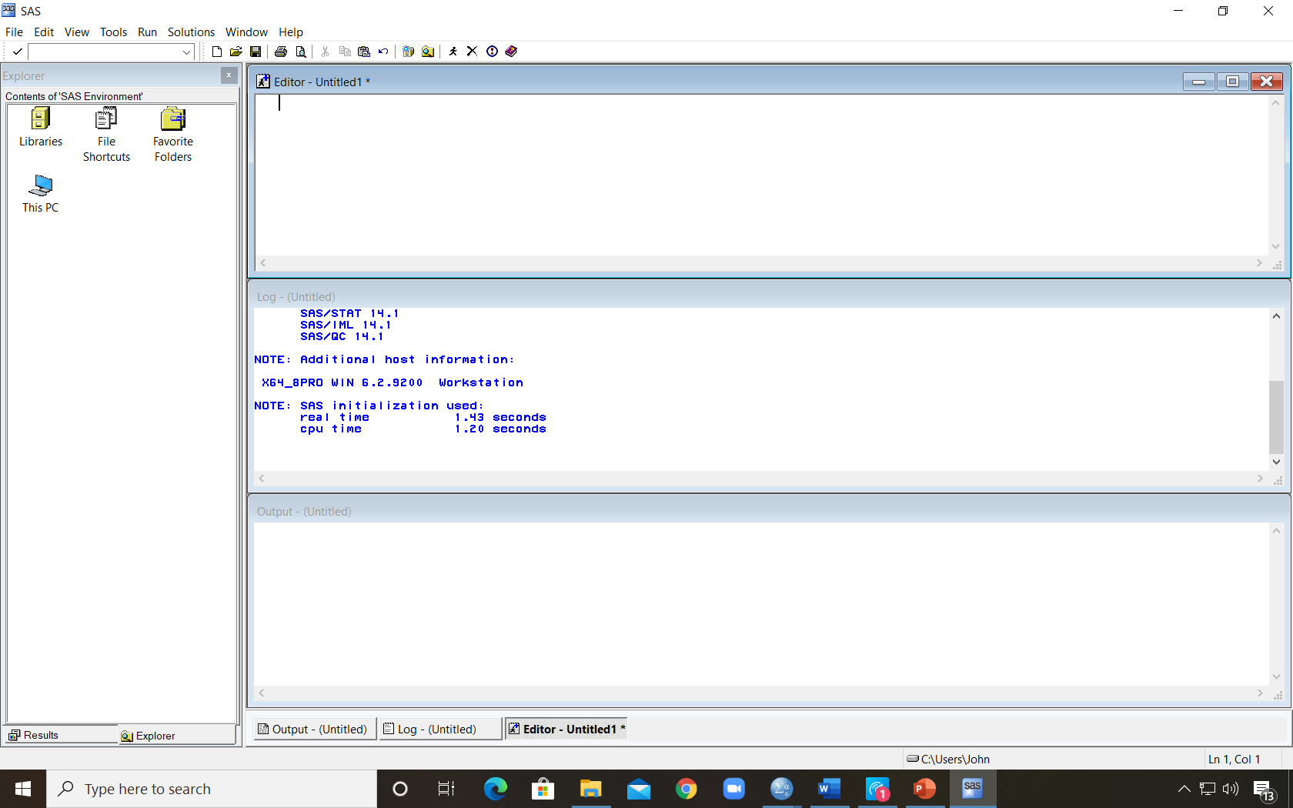
SAS Windows Environment
Editor Window
Log Window
Output Window

Slide 48
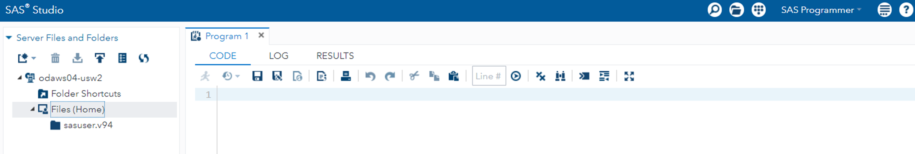
SAS ODA: SAS Studio Environment
Code window contains SAS program statements
Log window tab
Results window tab

Slide 49
SAS Basics
As an exercise:
read in the satisfaction data from the Excel file “OverallSatData.xlsx”
Label the file
Construct a frequency distribution and histogram of the satisfaction scores, and obtain the descriptive statistics
Create a 0/1 variable indicating top two box score
Construct a 95% interval estimate for the proportion of top 2 box responses.
Save the file created as a SAS file

Slide 50
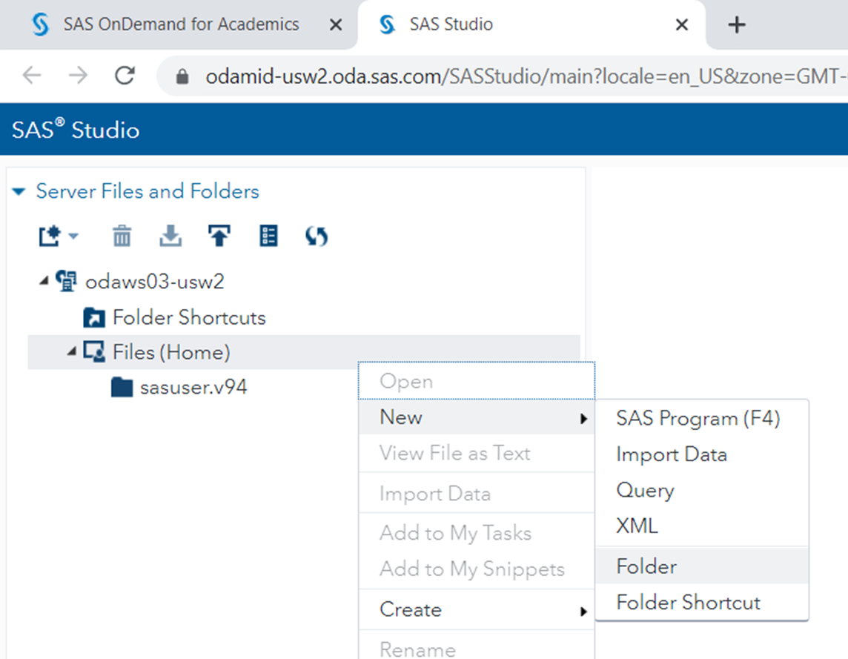
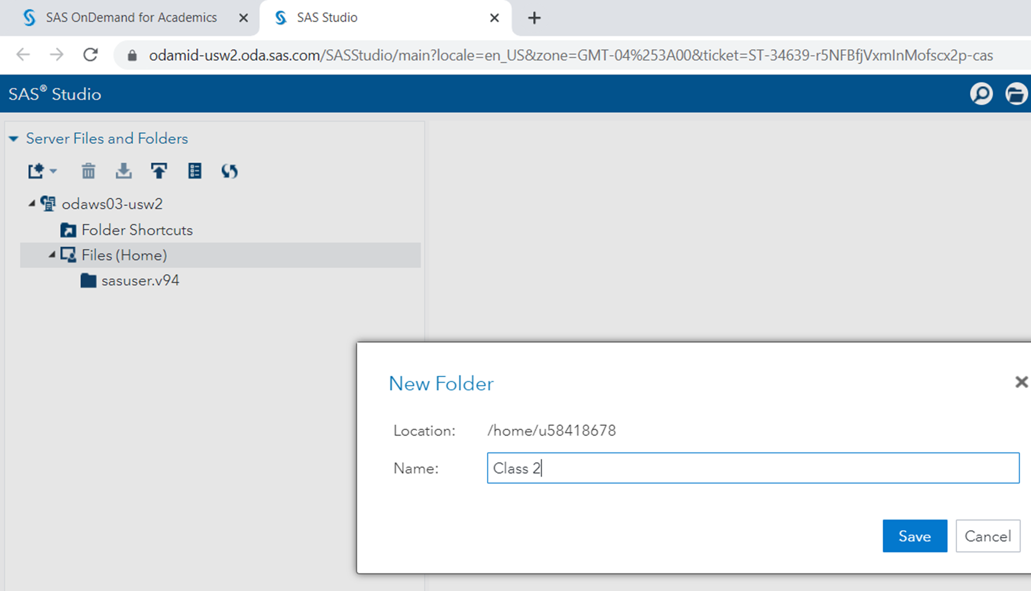
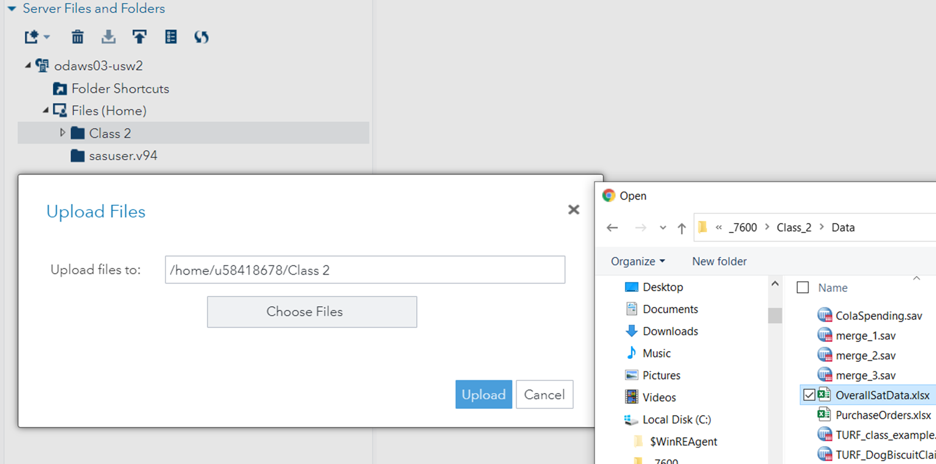
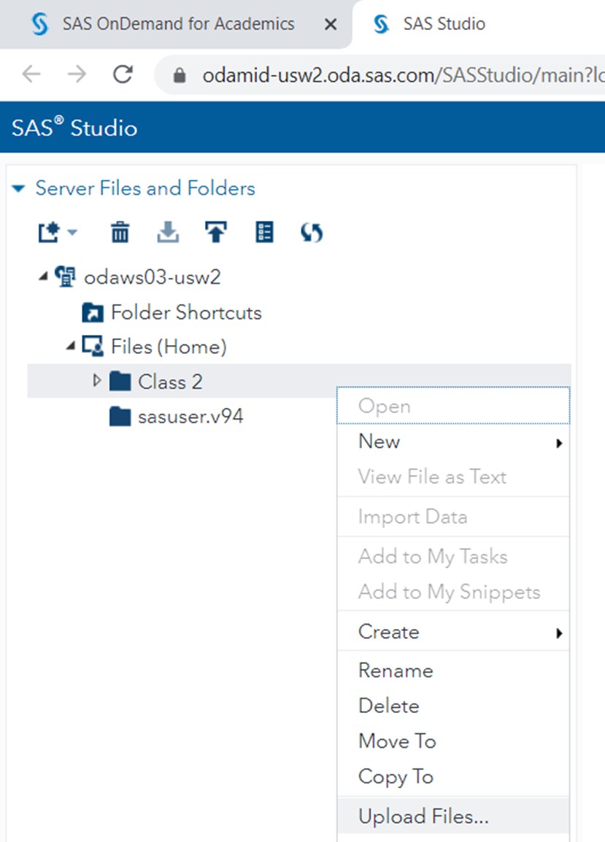
SAS On Demand for Academics (SAS ODA): Uploading Local Data
Right click on Files (Home) to create a new folder
Name the new folder
Right click the new folder and select Upload Files (note that files can also be downloaded)
Click on the file(s) you want to upload

Slide 51
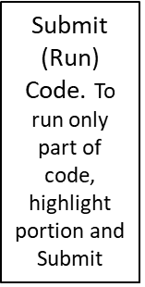
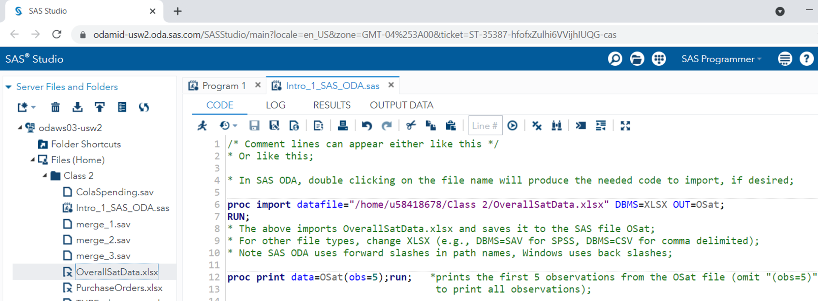
SAS ODA: Uploading Local Data
More Application Options (e.g., View Files and Folders)
Save and Save As
(Program saved as Intro_1_SAS_ODA.sas)
Clear Code
New Options (e.g., new program)
Refresh

Slide 52
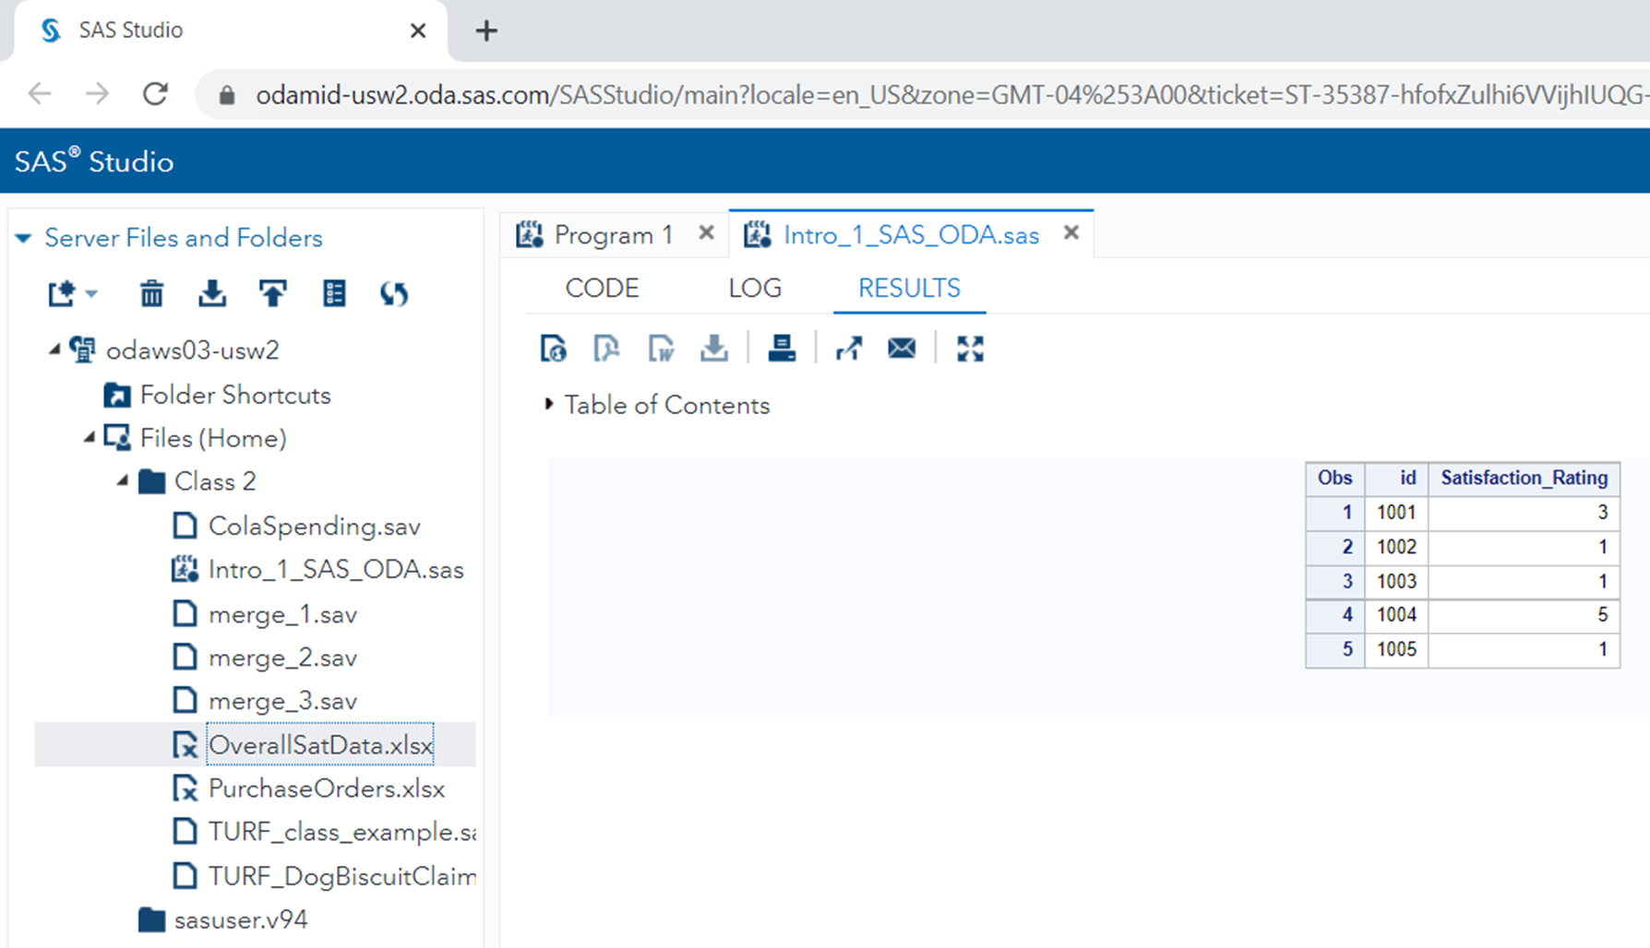
Result of Proc Print Statement
Download as PDF
Download as Word
Note: SAS Windows output/results can be copied and pasted from the output/results window

Slide 53
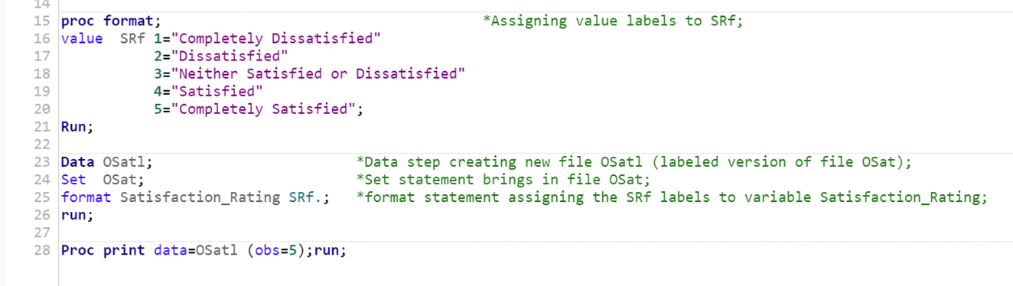
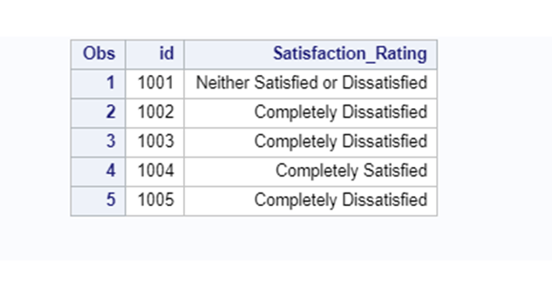
Label the file

Slide 54
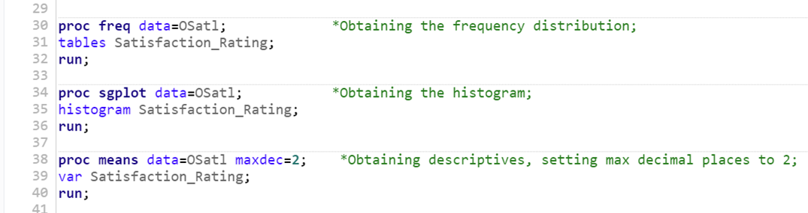
Construct a frequency distribution and histogram of the satisfaction scores, and obtain the descriptive statistics

Slide 55
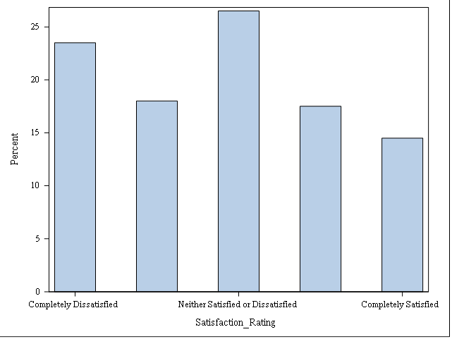
Construct a frequency distribution and histogram of the satisfaction scores, and obtain the descriptive statistics

Slide 56
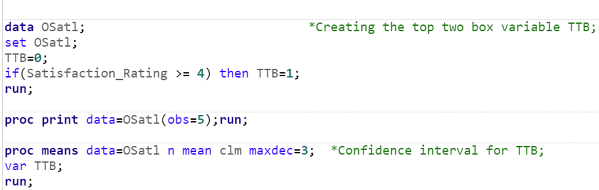
-Create a 0/1 variable indicating top two box score
-Construct a 95% interval estimate for the proportion of top 2 box
responses.

Slide 57
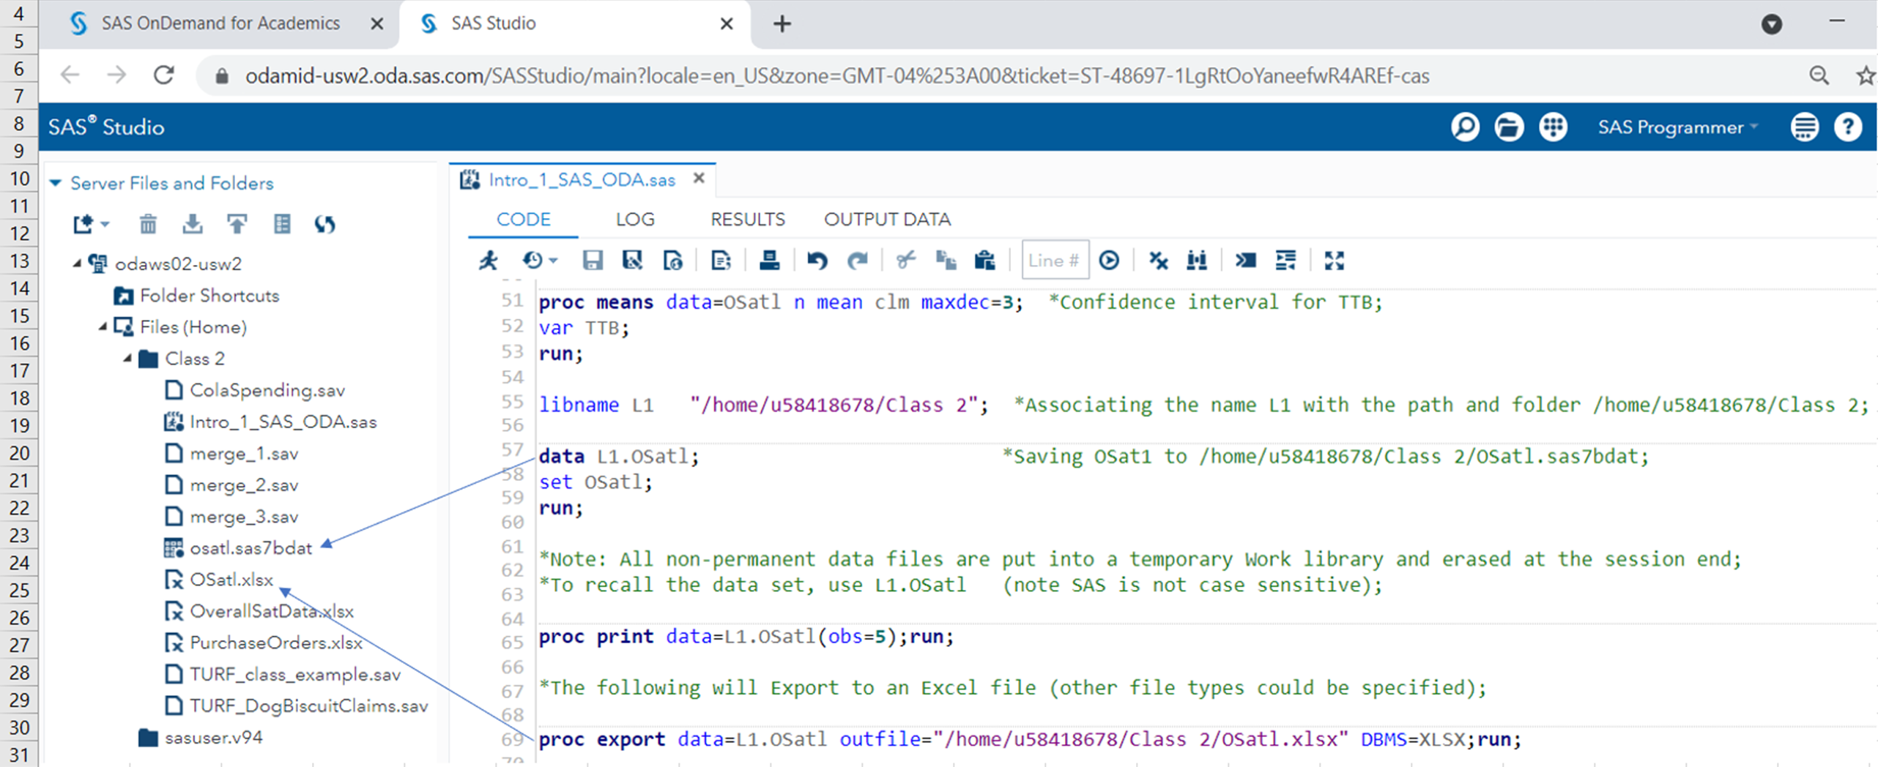
-Save the file created as a permanent SAS data set
A library reference name is needed and declared using a “libname” statement . It’s an alias used to refer to the folder where the file will be saved.

Slide 58
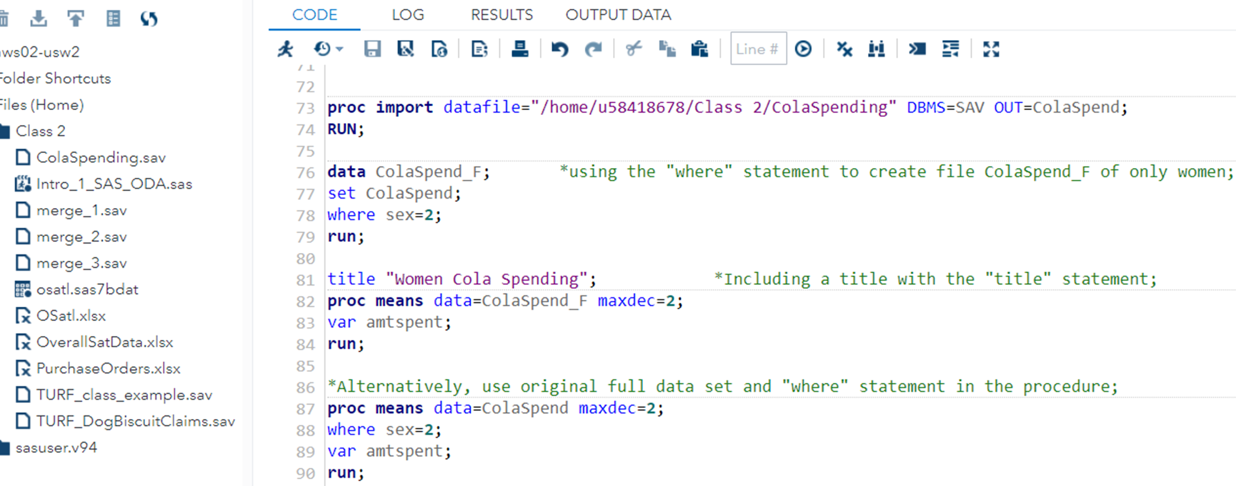
Selecting Cases in SAS
Recall the data set with age category (1= younger, 2= older), gender (male=1, female=2), and weekly cola spending amounts for 1000 respondents, saved in SPSS file ColaSpending.sav.
In the following example SAS is used to import the file, select only females, and descriptive statistics determined for that subgroup
Women Cola Spending

Slide 59
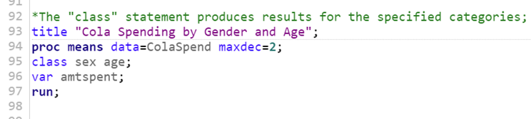
Simultaneous Subgroup Analysis in SAS
In the following example SAS is used to compute descriptives by gender and age for the ColaSpend data set.
Cola Spending by Gender and Age

Slide 60
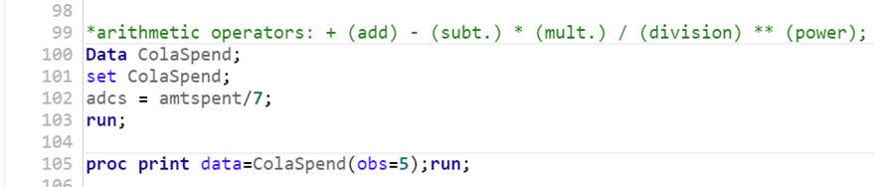
Performing Calculations in SAS Data Statements
In the following example SAS is used to compute average daily cola spend
For the ColaSpend data set.

Slide 61


Combining Data Sets by Adding Cases ( concatenation) and/or Adding Variables in SAS
In this example the files merge_1, merge_2, and merge_3 are created from entering data into the data step (rather than reading from a preexisting file). Next, the cases in merge_1 and merge_2 are combined, and that result combined with marge_3 (as in the SPSS example).
Adding Cases

Slide 62



Combining Data Sets by Adding Cases ( concatenation) and/or Adding Variables in SAS
Adding Variables
Recall m1m2

Slide 63
Additional Applications:
1) The Excel file President’s Inn Guest Database pro-vides a list of customers, rooms they occupied, ar-rival and departure dates, number of occupants, and daily rate for a small bed-and-breakfast inn during one month.4Room rates are the same for one or two guests; however, additional guests must pay an additional $20 per person per day for meals. Guests staying for seven days or more receive a 10% discount. Modify the spreadsheet to calculate the number of days that each party stayed at the inn and the total revenue for the length of stay.¹
2) The worksheet Base Data in the Excel file Credit Risk Data provides information about 425 bank customers who had applied for loans. The data include the purpose of the loan, checking and savings ac-count balances, number of months as a customer of the bank, months employed, gender, marital status, age, housing status and number of years at current residence, job type, and credit-risk classification by the bank.¹
a. Use the COUNTIF function to determine (1) how many customers applied for new-car, used-car, business, education, small-appliance, and furniture loans and (2) the number of customers with checking account balances less than $500.
b. Modify the spreadsheet using IF functions to include new columns, classifying the checking and savings account balances as low if the balance is less than $250, medium if between $250 but less than $2000, and high otherwise.
¹Evans,J. Business Analytics, 2nd Edition, Pearson

Slide 64
Added Applications
3) Red Deer makes dog biscuits and is interested in assessing the potential of 10 different claims they are considering (see next slide). A survey of 300 dog owners was conducted and respondents were asked to rate the relevance of each claim to dog biscuits on a scale from 1 (not at all relevant) to 5 (extremely relevant). SPSS file “TURF_DogBiscuitClaimData.sav” contains the data with the claims provided in the labels. The client is interested in conducting a TURF using this data. Conduct a TURF examining solutions with up to 6 variable/claim combinations (group sizes up to 6 claims), and display 5 solutions for each variable/claim combination (group). Consider a respondent as reached if a claim has a rating of at least 4.
What percent of the 300 respondents is reached with your best 4 claim solution?

